Slide 1




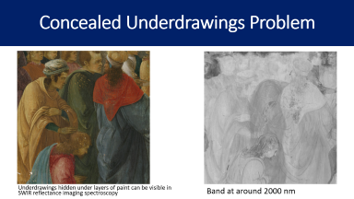
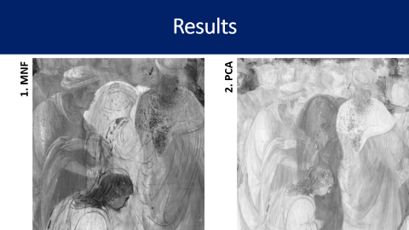
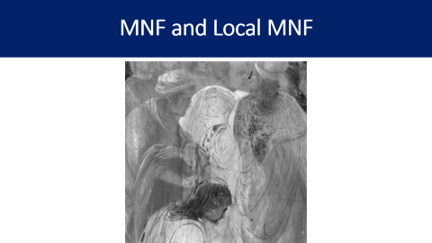


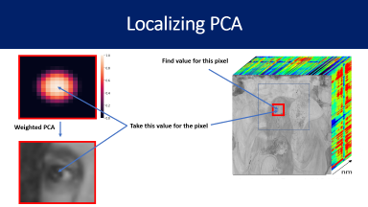

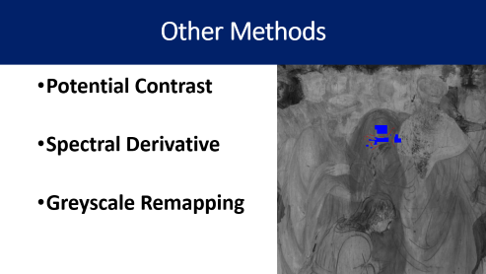
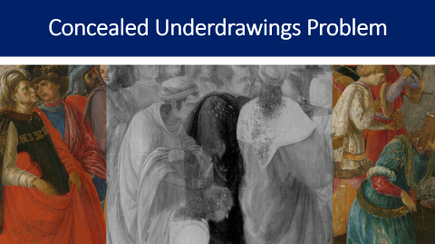
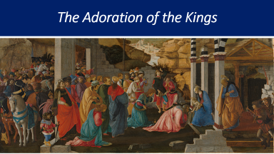

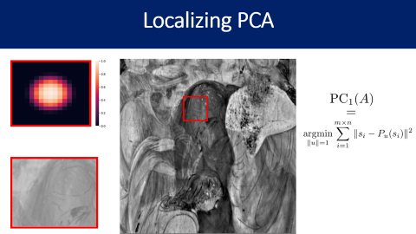

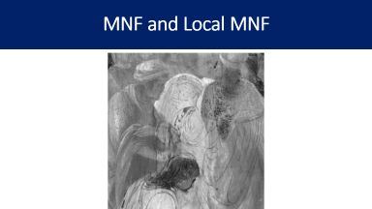

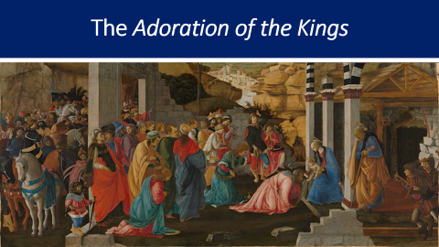
Enhancing Underdrawing Visualization using Adaptive and Localized Image Analysis of Reflectance Hyperspectral Imaging Data from a 15th Century Painting
Wallace Peaslee^{1,2}, Marta Melchiorre Di Crescenzo³, Nathan Daly³, Ingrid Daubechies^{1,4}, Shira Faigenbaum-Golovin¹, Catherine Higgit^{3,} Barak Sober⁵
1. Department of Mathematics, Duke University, US. 2. Department of Computer Science, Duke University, US. 3. The Scientific Department, National Gallery, London, UK. 4. Department of Electrical and Computer Engineering, Duke University, US. 5. Department of Statistics and Data Science, The Hebrew University of Jerusalem
1
3
5
2
4
6
GitHub Repository

Slide 2
Click Here For Instructions
Click a portion of the poster to learn more relevant information.
Clicking will bring you to a few slides.
Once you have completed the small set of slides, you will return to the main poster automatically
Please have the presentation in “Presenter mode” for this poster to function properly.

Slide 3
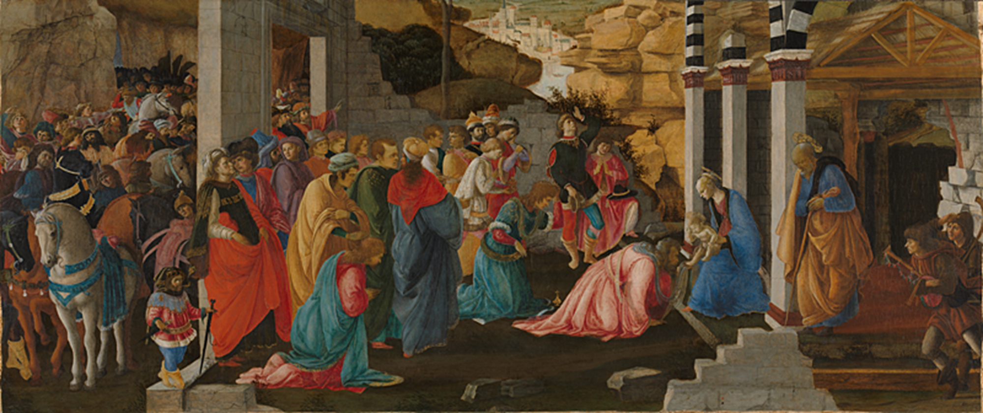

The Adoration of the Kings
The Adoration of the Kings is a tempura on wood painting completed by Sandro Botticelli and Filippino Lippi around 1472.
We use details of this work as a case study for methods to enhance visualization concealed underdrawings.
Return to poster
More details

Slide 4
The Adoration of the Kings
The Adoration of the Kings is a tempura on wood painting completed by Sandro Botticelli and Filippino Lippi around 1472.
We use details of this work as a case study for methods to enhance visualization of concealed underdrawings.
Return to poster
More details

Slide 5
The Adoration of the Kings
The Adoration of the Kings
Sandro Botticelli (about 1445 – 1510) and the young Filippino Lippi (about 1457 – 1504) collaborated on this work. The crowd on the left is characteristic of Boticelli’s work, while the figures in the central foreground are most likely done by Filippino.
The painting may have been made as part of a piece of furniture and reflects the popularity of the Adoration of the Kings in Florence.
Any other details I should highlight/include?

Slide 6
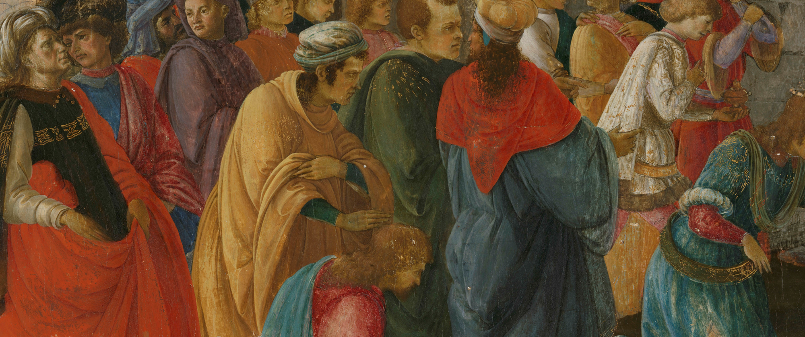
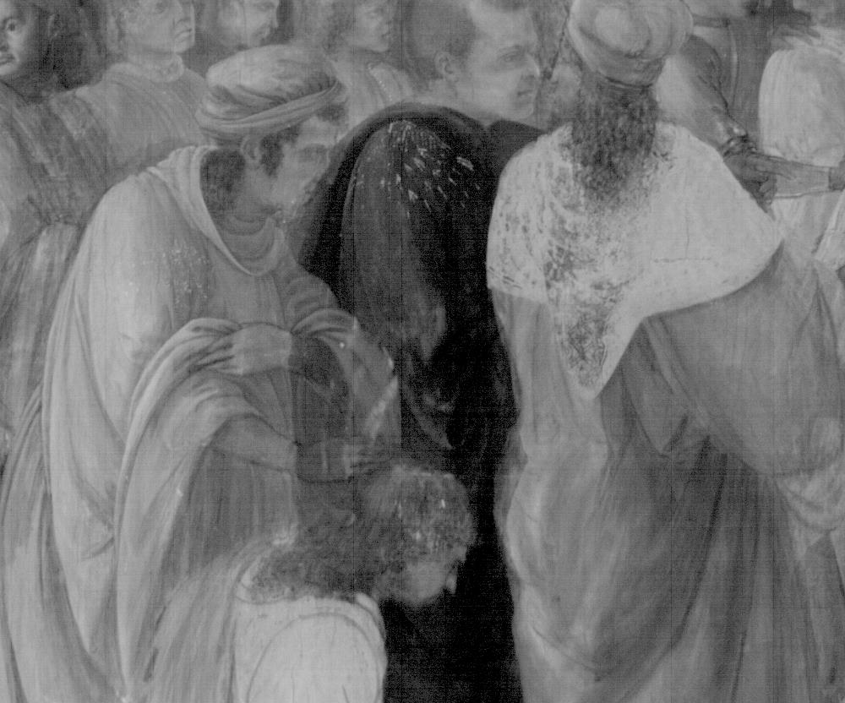
Concealed Underdrawings Problem

Slide 7
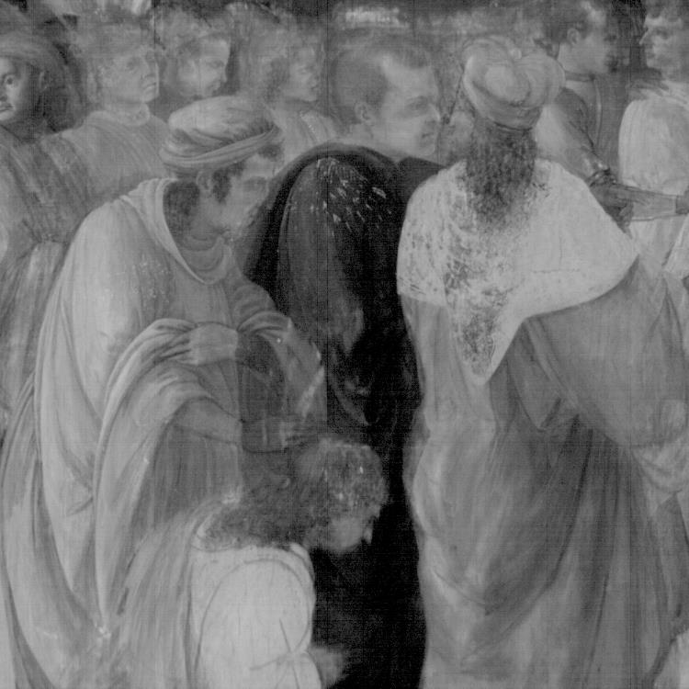
Concealed Underdrawings Problem
We use reflectance hyperspectral imaging data to provide visualizations of concealed underdrawings.
Shortwave infrared wavelengths (SWIR).
Challenges:
High dimensionality of hyperspectral data.
Spatial heterogeneity of paintings.
Return to poster
More details
Reflectance imaging spectroscopy, around 2000nm.

Slide 8

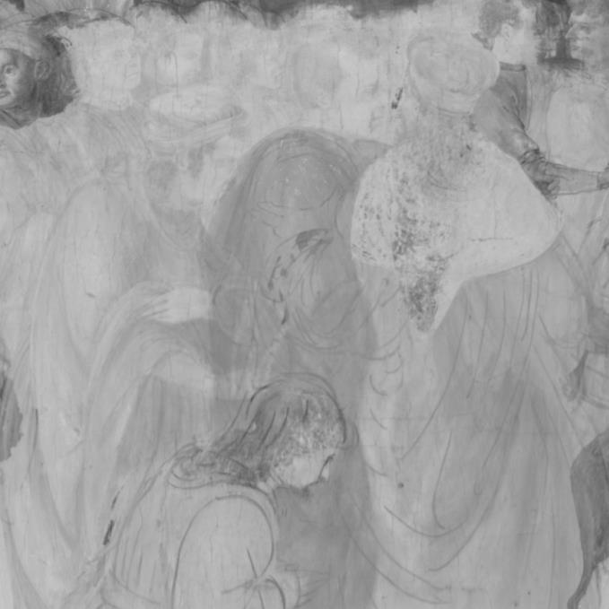
Concealed Underdrawings Problem
Different parts of the underdrawing may be more or less legible in certain wavelength ranges.
Reflectance imaging spectroscopy, around 2000nm.
Reflectance imaging spectroscopy, around 1870nm.

Slide 9
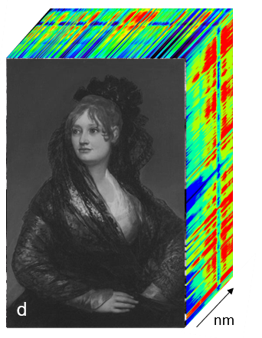

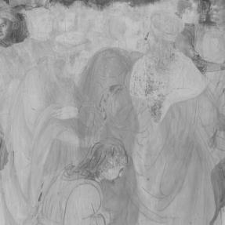
Concealed Underdrawings Problem
The SWIR reflectance hyperspectral imaging data includes over 500 bands between 1000 nm and 25000 nm.
Preprocessing step: remove rows of noise with extreme values.
A few bands from the dataset include rows of pixels with extreme values.
The rows are automatically detected (via a threshold when compared to the same row of nearby bands in the hyperspectral cube).
The rows of extreme values replaced with a linear interpolation of the same rows from adjacent bands in the hyperspectral cube.

Slide 10
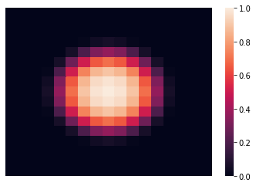
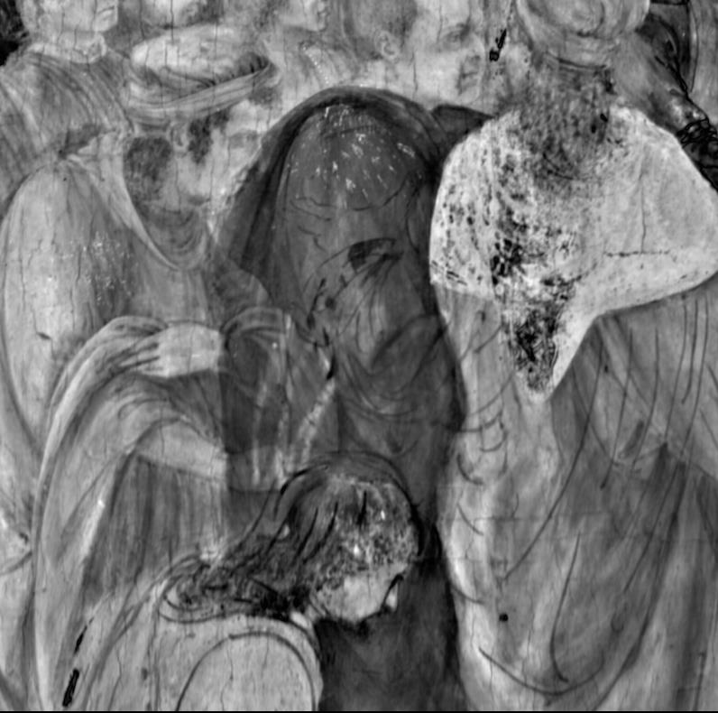
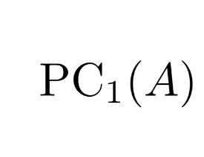
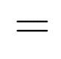
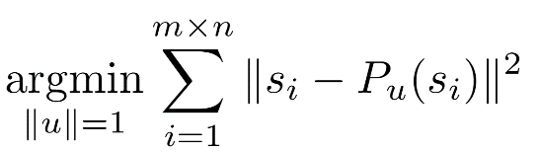
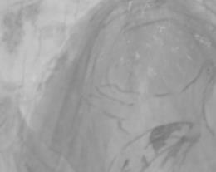
Localizing PCA

Slide 11
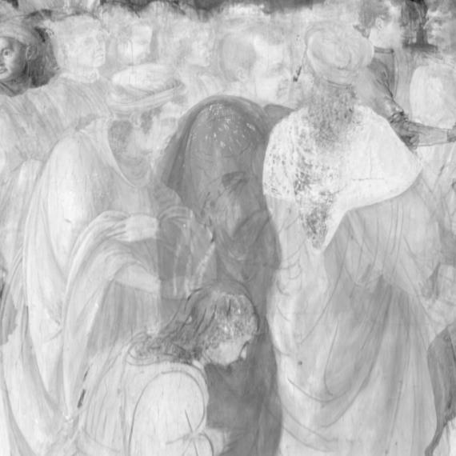
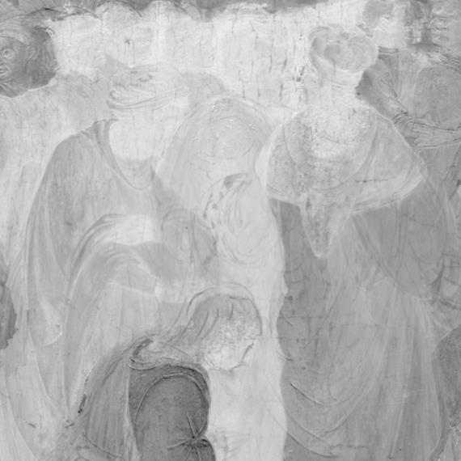
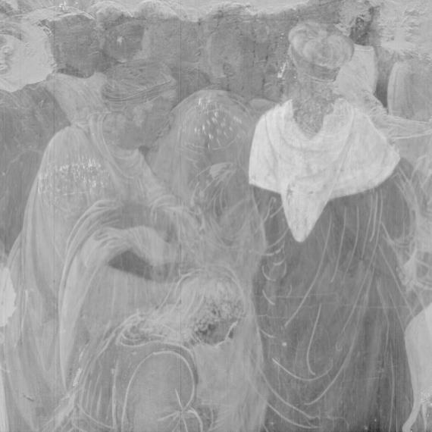
Localizing PCA
Principal Component Analysis (PCA) is a global dimension-reduction method that can be beneficial for underdrawing enhancement.
The hyperspectral cube is projected onto the first Principal Components (PCs) below.
1
2
3

Slide 12
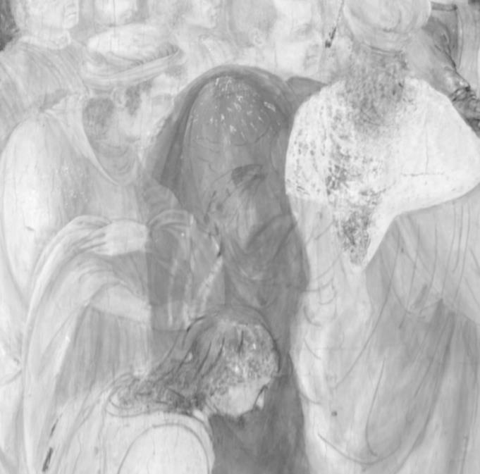
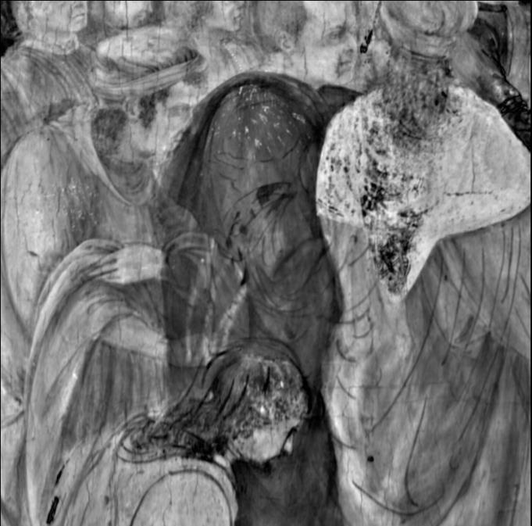
Localizing PCA
We can spatially localize PCA, taking into account the heterogeneity of the painting and utilizing spatial information.
Local PCA result.
Each pixel of the hyperspectral cube is projected onto its first local principal component (which is computed using pixels within a 100-pixel radius).
Global PCA result.
The hyperspectral cube is projected onto the first principal component.

Slide 13
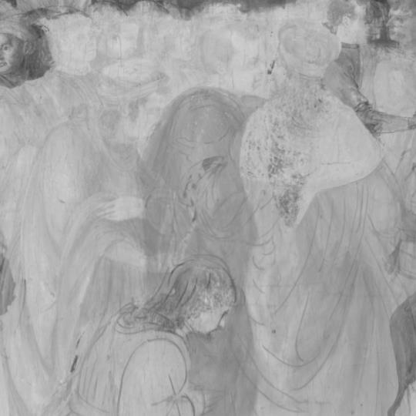
Localizing PCA
To compute the local PCA, we use a pixel-by-pixel (or window-by-window) approach.
For each pixel, we spatially weight the hyperspectral cube by distance to that pixel and run PCA on that weighted neighborhood.
Weighted pixels

Slide 14

Localizing PCA
Local PCA is motivated by spatial heterogeneity in paintings, especially arising from differences in overlying pigments.
Moreover, local PCA aims to automatically include the best underdrawing visualization in a single image and provide consistency across regions of a painting.
We see that using local spatial information can be beneficial for the PCA method, increasing underdrawing line legibility under paint passages containing pigments with different compositions.

Slide 15
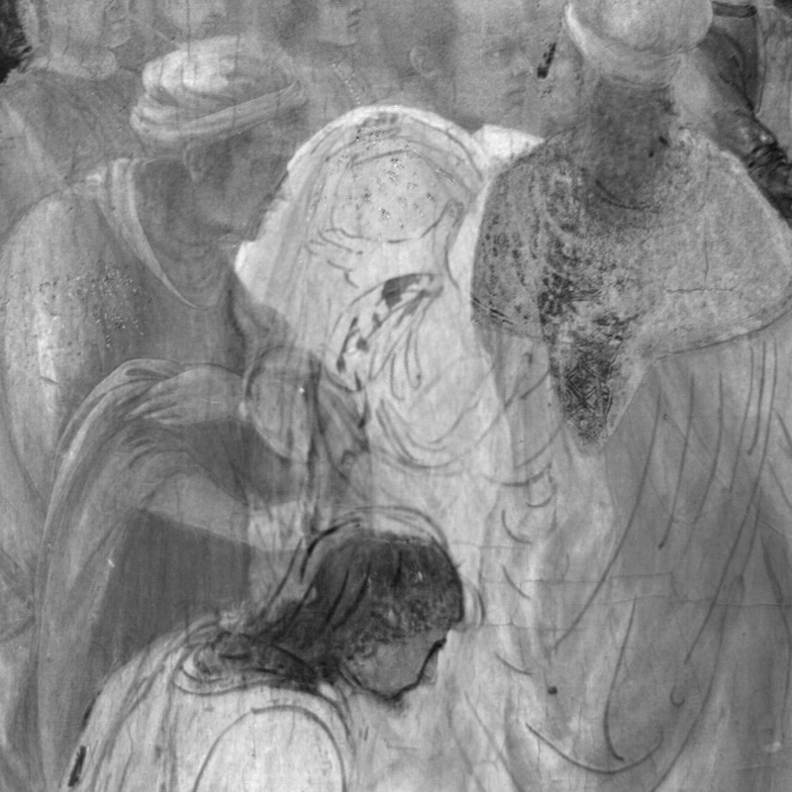
MNF and Local MNF
Maximum Noise Fraction

Slide 16
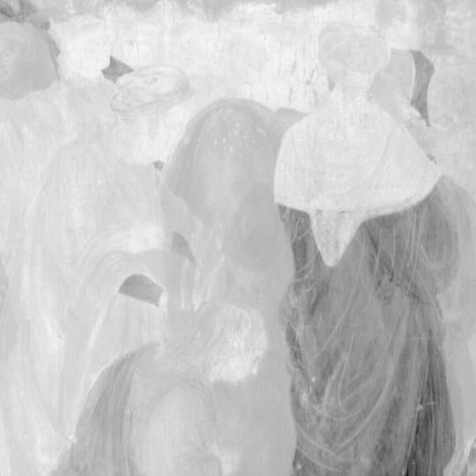
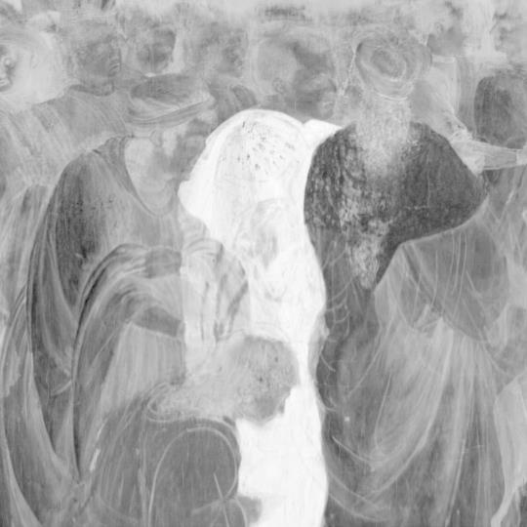
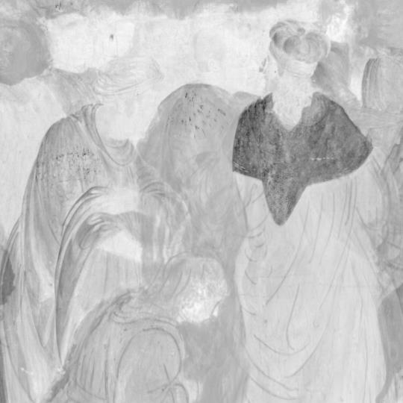
MNF and Local MNF
The Maximum Noise Fraction (MNF), like PCA, is a global dimension-reduction method that we can use for underdrawings visualization.
The reflectance hyperspectral cube is projected onto the first MNF components below.
1
2
3

Slide 17
MNF and Local MNF
The MNF transform aims to maximize the signal-to-noise ratio of projections (rather than variance as in PCA).
Often underdrawings are clearest in later projections onto later MNF components.
On the right is the projection onto the fourth MNF component.

Slide 18
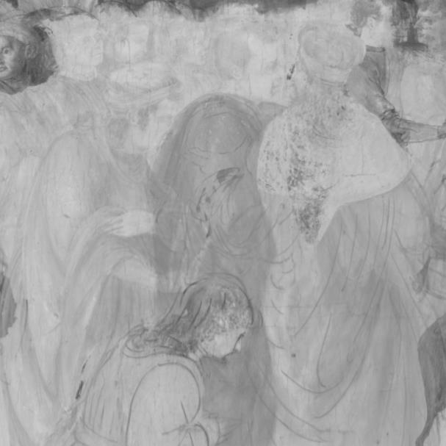
Global and Local MNF
We can localize MNF like we localize PCA. However, for local MNF to be effective, we need to estimate noise statistics globally or with a larger neighborhood than the (weighted) pixels we consider for computing MNF components.
Local MNF Result here
Pixels used for computing local MNF noise statistics
A local MNF result.
Weighted pixels

Slide 19

Results
1. MNF
2. PCA

Slide 20
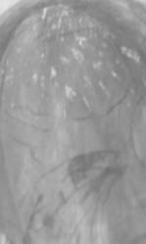
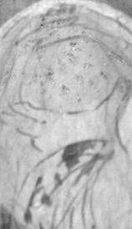
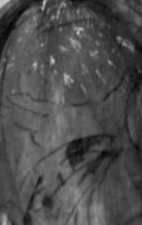
Results
Will add Local MNF
Or otherwise
Include other results
To complete this.
Global PCA
Global MNF
Local PCA

Slide 21
Results
Perhaps a second slide of results/from another (bigger or more challenging) patch. Will add these once completed. (I could also add methods on a subset of the best bands, rather than all bands from 1000nm-25000nm.)
Maybe quantitative measurements with potential contrast would be useful? Or maybe they would be confusing?

Slide 22

Results
We find that using local spatial information can be beneficial for the PCA method, increasing underdrawing line legibility under paint passages containing pigments with different compositions.
Local methods can provide improved consistency, especially across larger segments, as the local methods are insensitive to patch selection.
Local PCA

Slide 23
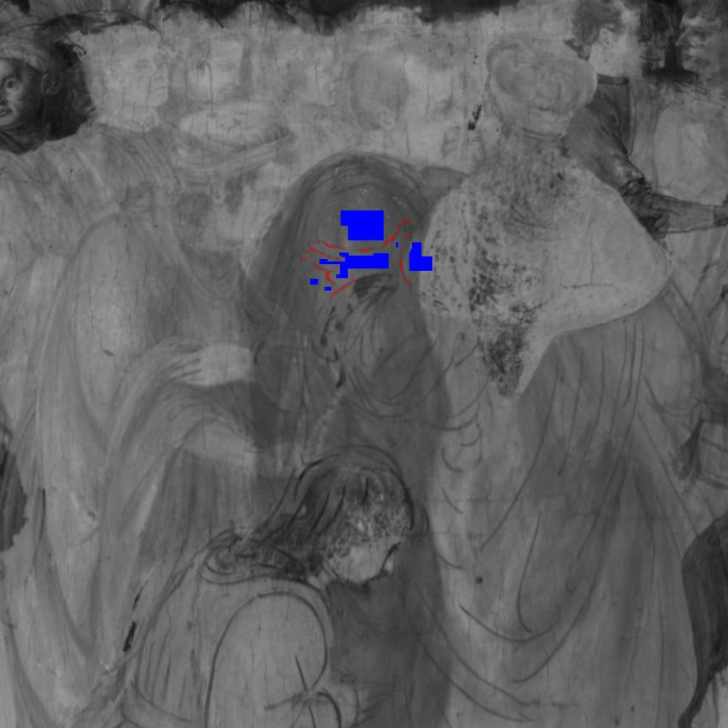
Other Methods
Potential Contrast
Spectral Derivative
Greyscale Remapping

Slide 24
Potential Contrast
Potential contrast provides a way to quantify
Applications
Find best bands or regions of a hyperspectral cube (next slide).
Perform PCA or other methods on only the best bands or best regions.
Quantify the quality of MNF or PCA projections or other results.
Return to poster
More details
Sampled Underdrawings
Sampled Background

Slide 25
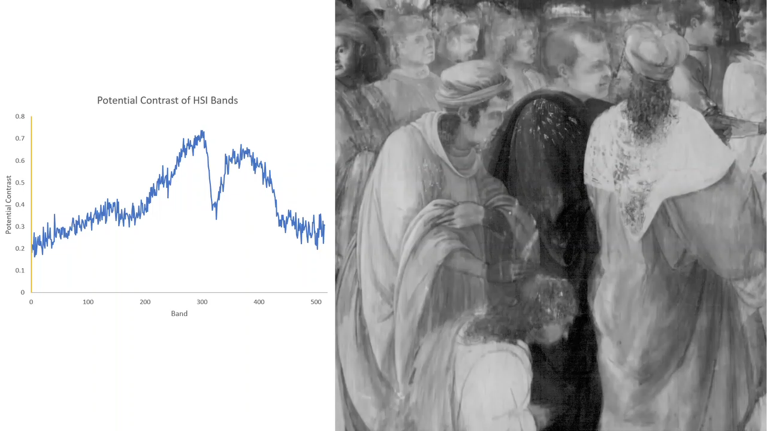
Play the video to see each band of the hyperspectral cube and the corresponding Potential Contrast value.
Notes:
Botticelli and Lippi,
Adoration of the Kings
, about 1470
(NG592 for reference)

Slide 26
Spectral Derivative
I might also add spectral derivative results.
Underdrawings stay more constant across hyperspectral bands (variance is lower), so they appear in the derivative.
Cracks are less visible.
Can help distinguish underdrawings from other, possibly confusing, details.

Slide 27
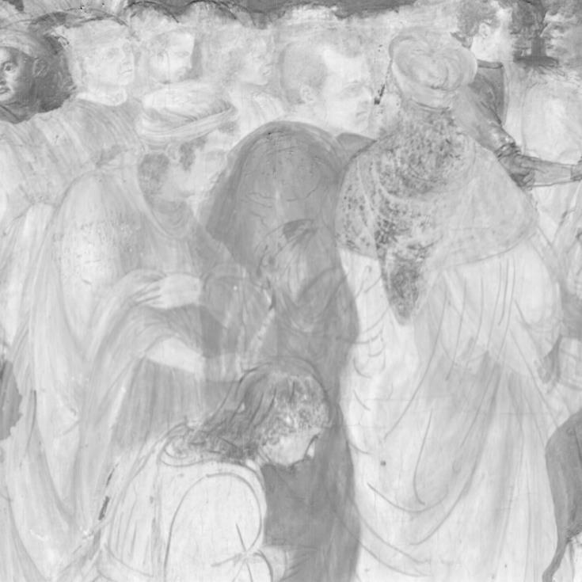

Greyscale Remapping
We can also remap greyscale values to improve result clarity.
Global PCA
Global PCA with greyscale remapping

Slide 28


References & Acknowledgements
Here’s a place to put additional references or acknowledgements

Slide 29
Here’s a place to put additional references or acknowledgements

